Slide 1


Troubleshooting

Slide 2
Contents
Measuring issues
Installation
Process conditions
Communication
Field and Host communication
TRL/2 bus
Field devices
Finding error codes
Default loading
Upgrade firmware
TankMaster
Missing input values
Missing volume calculation
Value status
Upgrading TM
Service tools
Hardware and software toolbox
Support from factory
How to get information
How to contact us

Slide 3
Measuring Issues: Installation & Process Conditions

Slide 4
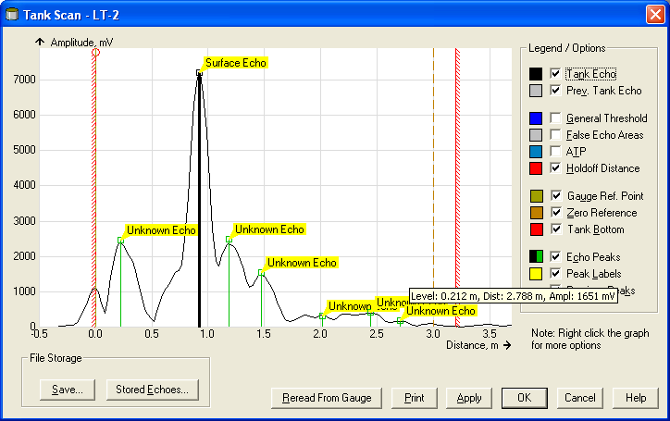
Tank Scan
Best service tool!
Visualize what the gauge see in the tank
Gives a good picture of the situation in the tank
Installation condition
Echo amplitude from surface
If there are any disturbing echo present
In Tank scan you can
Adjust general threshold
Create custom threshold
Register disturbing echoes.

Slide 5
Tank Scan
Tank zero point
Tank Bottom
R distance
Gauge zero point

Slide 6
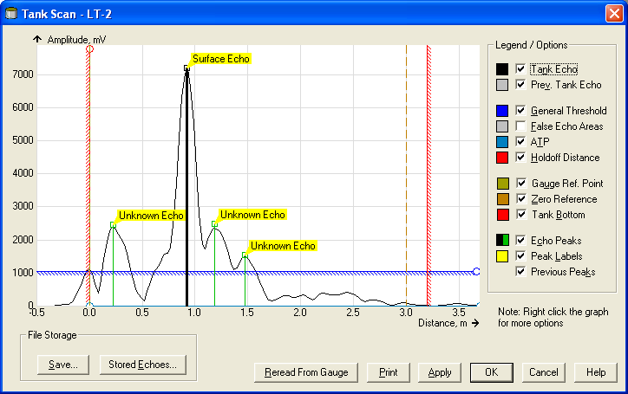
Tank Scan
General threshold
All echos below general threshold is ignored by the gauge

Slide 7
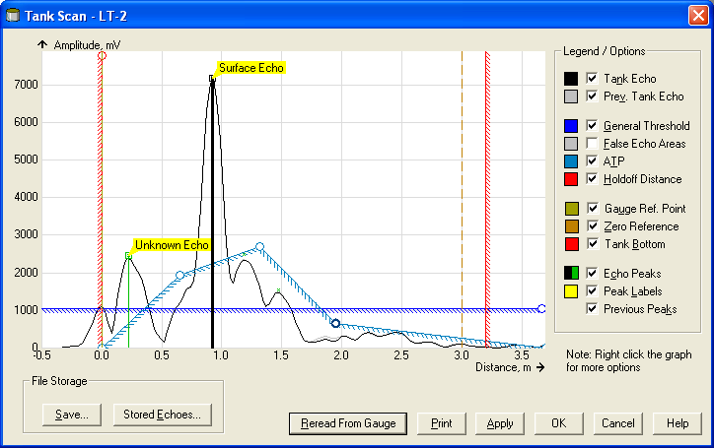
Tank Scan
Custom Amplitude Threshold Point
All echos below Amplitude Threshold Points curve is ignored by the gauge

Slide 8

Tank Scan
Registered disturbance echo area
The gauge is not allowed to lock on an echo which is located inside the registered disturbance area

Slide 9
Measuring problems
Disturbing echoes most common problem!
Normally caused by a wrong mechanical installation.
Could make gauge
Show wrong level
Give inaccurate reading
Loose track of surface echo during filling/emptying
Typical faults
To narrow or high nozzle
Internal obstacles below gauge in tank
Strong bottom echo, no deflection plate at end of still pipe

Slide 10
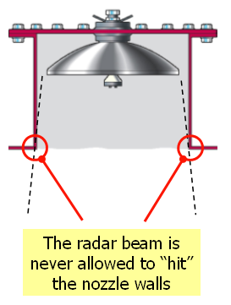
Too high nozzle
Creates a big disturbing echo close to the antenna
Could affect the accuracy of level reading in the complete measuring range
Makes amplitude from surface echo weaker
Could make the gauge getting stuck in top of tank and not track surface echo
Solution
Shorten the nozzle!
SPECTRA

Slide 11
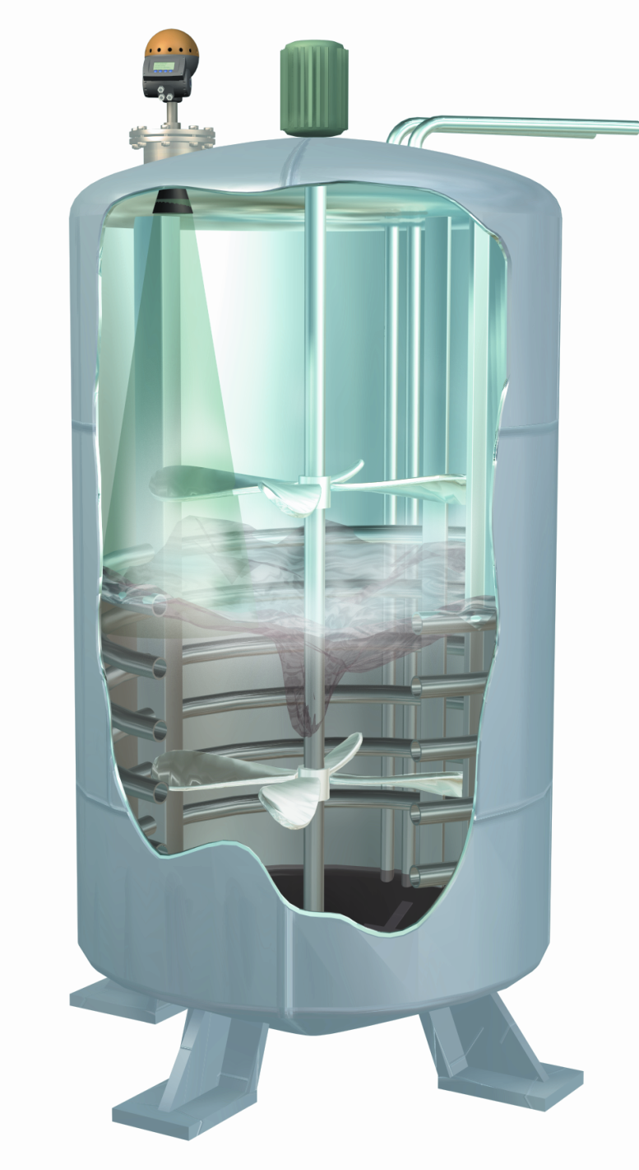
Internal obstacles in tank
Internal obstacles
Supporting beams
Heating coils
Agitators
Could make gauge
Get stuck on disturbance echo when filling/emptying
Inaccurate reading when passing disturbance echo
Inaccurate reading when level is below disturbance echo
Measuring could suddenly jump from surface echo to disturbance echo

Slide 12
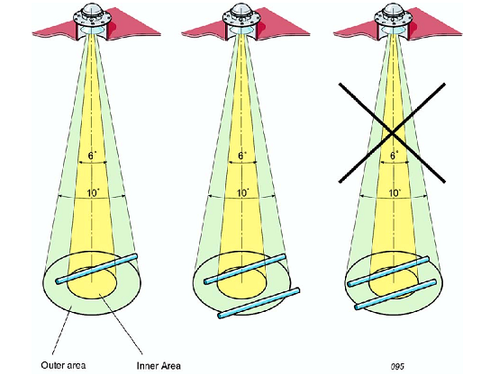
Internal obstacles in tank
Solution
Remove disturbing echo!
Mount gauge in other location of tank
A bigger antenna gives a smaller radar foot print!

Slide 13
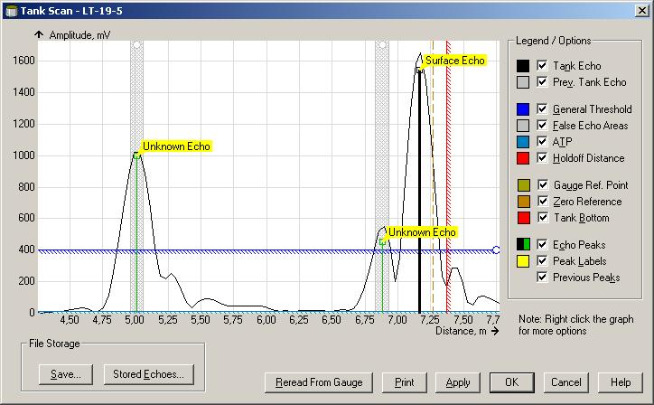
Internal obstacles in tank
Solution
Remove disturbing echo!
Mount gauge in other location of tank
Rotate gauge 90° to minimize echo

Slide 14
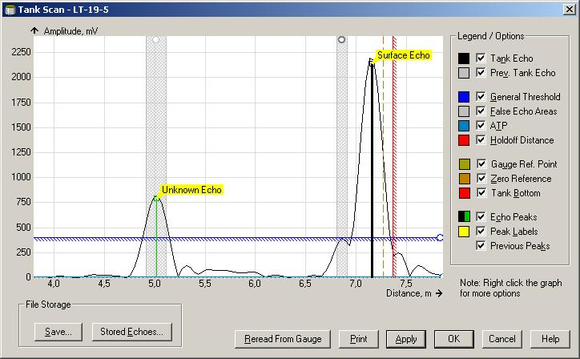
Internal obstacles in tank
Solution
Remove disturbing echo!
Mount gauge in other location of tank
Rotate gauge 90° to minimize echo

Slide 15
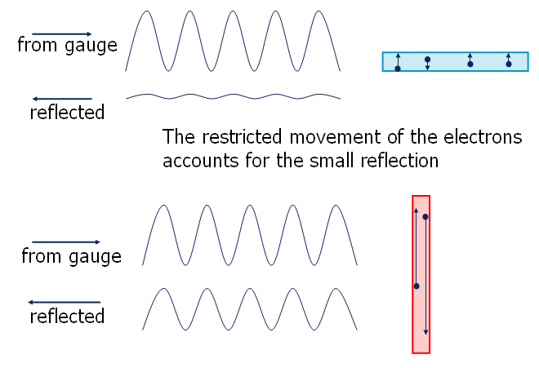
Internal obstacles in tank
Solution
Remove disturbing echo!!
Mount gauge in other location of tank
Rotate gauge 90° to minimize echo

Slide 16
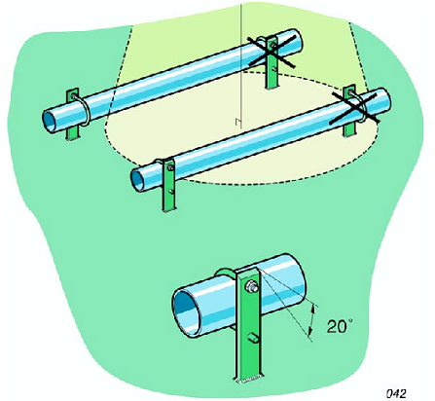
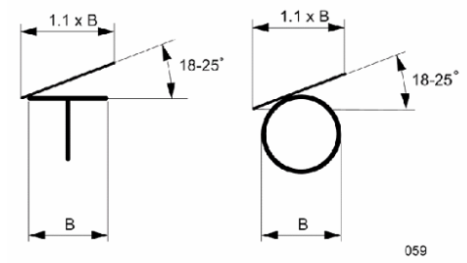
Internal obstacles in tank
Solution
Remove disturbing echo!!
Mount gauge in other location of tank
Rotate gauge 90°
Mount deflection plates on object making disturbance echo smaller

Slide 17
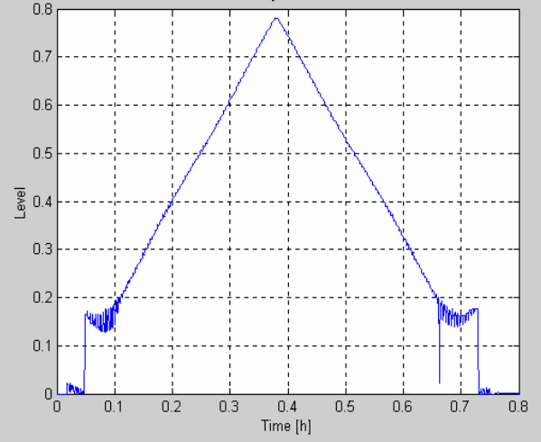
Strong bottom echo
Strong bottom echo
Caused by
Flat bottom with clean product
Still pipe without deflection plate
Could make gauge
Inaccurate reading close to bottom <500mm
Level jump down to tank bottom at low levels
Level get stuck at bottom when starting to fill an empty tank

Slide 18
Strong bottom echo
Solution
For free propagation tanks only configuration of gauge is possible. (Very unusual)
General Threshold
General Threshold
FHAST
Filter
FHAST
Filter

Slide 19
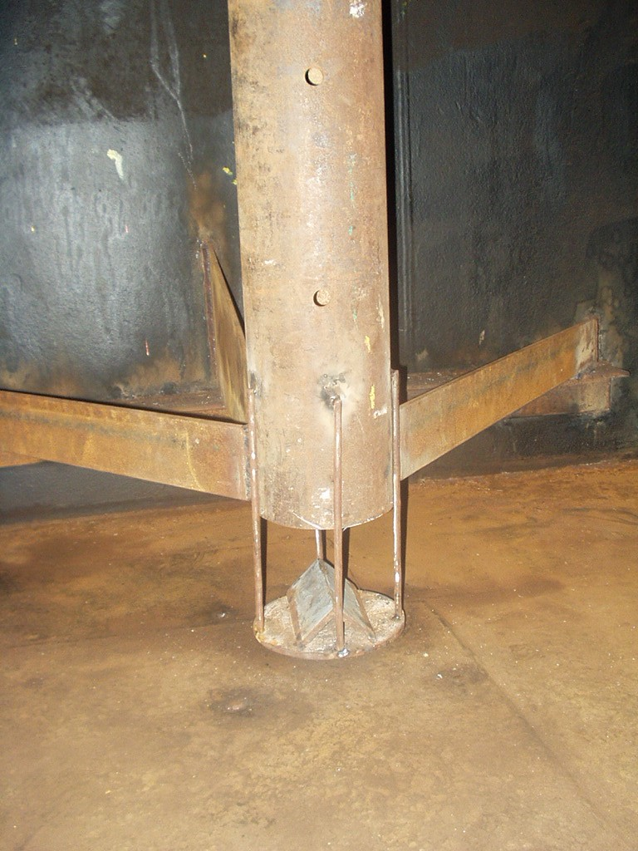
Strong bottom echo
Solution:
For free propagation tanks only configuration of gauge is possible. (Very unusual)
For Still pipe a deflection plate should be installed

Slide 20
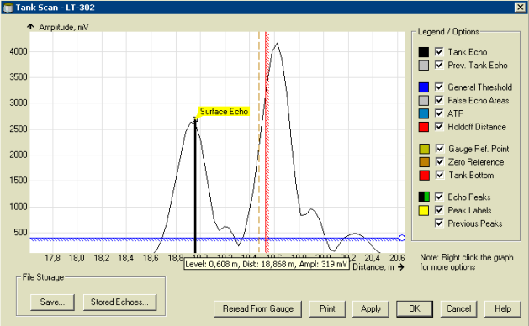
Strong bottom echo
Solution:
For free propagation tanks only configuration of gauge is possible. (Very unusual)
For Still pipe a deflection plate should be installed
Still pipe installation
Before deflection plate

Slide 21
Strong bottom echo
Solution:
For free propagation tanks only configuration of gauge is possible. (Very unusual)
For Still pipe a deflection plate should be installed
Still pipe installation
After deflection plate

Slide 22
Tank Environment
There are many different process conditions in a tank which can affect the measurement.
Rex and Pro has several software functions in order to handle these conditions
Disturbing echoes : Gauge avoids to lock on false echoes
Foam : Gauge much more stable for erratic changes in level
Turbulent surface : Gauge much more tolerant for weak echoes
Double surface : Gauge can track lower or upper surface
Double bounces : Gauge does not lock on double bounces
Vapor : Gauge can make correction for vapor influence (LPG)
Special correction table : Gauge can make a level correction due to movements in tank
And more....

Slide 23
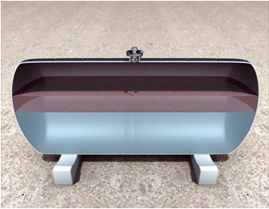

Tank Environment
Double surface
Upper surface level
Product 2
Lower surface level
Product 1

Slide 24
Tank Environment
Tracking example when Tank bottom is not visible

Slide 25
Gauge is not tracking the level…
The level is still but the gauge is showing error:
Look at the spectra
It might be necessary to decrease general amplitude if amplitude from surface echo is close or lower than general threshold
The actual level is moving but the gauge not:
The gauge has probably locked on a disturbing echo
Echo lost below “0”
Check if level/tank bottom is below R+C distance, increase C distance
“Normal error” due to round bottom, use empty tank handling

Slide 26
Unstable level
The accuracy can be affected in a number of ways – most of the time the gauge is measuring correctly…
General threshold might need to be increased if the gauge picks up noise
Foam islands can make the level jump when foam is passing under the antenna.
Double surface is making the gauge jump between upper and lower echo
The tank can be moving due to instable roofs, strong winds
There is gas in the product
There is a disturbance echo close to the surface echo

Slide 27
Disturbing echoes
The gauge can not see the difference between a disturbing echo and a product echo
Disturbing echoes can affect the level accuracy when the product level is passing the disturbance
After registering a disturbing echo, the gauge is not allowed to lock on that echo
However, the echo is still consuming a lot of energy, so it’s preferable to remove the cause of the disturbing echo if possible

Slide 28
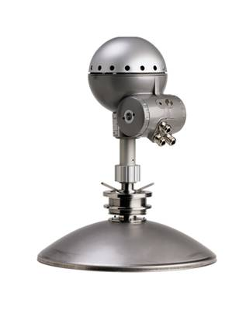


Registering disturbing echo
Always register a disturbing echo when product surface is below.

Slide 29
Registering disturbing echo
Never register disturbing echoes which are in the product…

Slide 30
Registering disturbing echo
… they will not remain in that position!

Slide 31
Passing a disturbance echo
No threshold

Slide 32
Passing a disturbance echo
ATP threshold around disturbance echo

Slide 33
Passing a disturbance echo
False echo registered around disturbance echo

Slide 34
Communication: Field and Host communication & TRL/2 bus

Slide 35
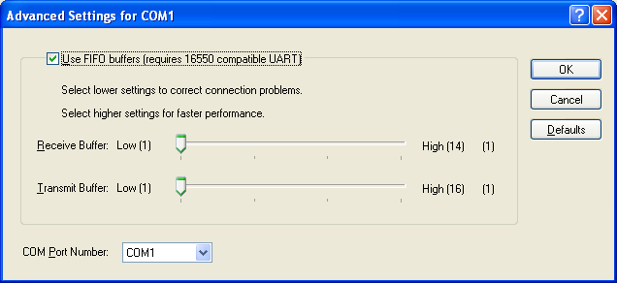
Communication TankMaster
Communication problems appearing as short CFAILS
Check if incorrect COM-port Buffer settings
Buffer settings – can be found under Device Manager – Com ports – Advanced Com port settings
Both should be set to Low

Slide 36
Communication TankMaster- FCU
To field equipment via Modbus protocol
Real time log can be viewed from Win Setup
Statistic data for the communication
In normal operation TankMaster should only send questions to FCU

Slide 37
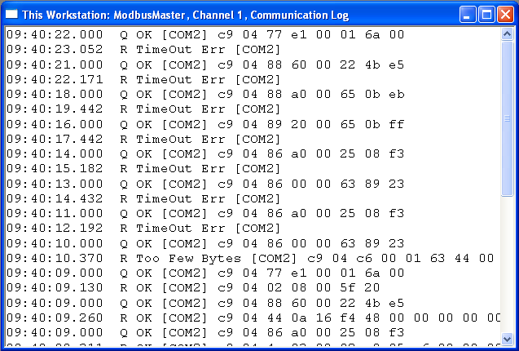
Communication TankMaster- FCU
Errors in communication-log
Timeout error: Device does not answer
Check Cabling, FBM, Power to unit, Modbus address
Checksum error: Device answer but checksum is wrong
Check cabling, baud rate, parity, number of data bits..
Overrun error: Device is answering but message is corrupt
Check cabling, baud rate, parity, number of data bits..
Too few bytes: Received message is not long enough
Check cabling, reply timeout
Notes:
If OK, you know that you have good communication
TM should only ask FCU

Slide 38
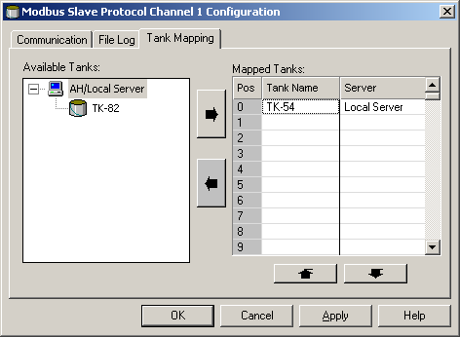
Communication TankMaster- HOST
TankMaster acts a slave
TankMaster Modbus Slave ’database’ must be configured
Mapped Tanks can be set in any order
How to configure a HOST to read from TankMaster?
Document TM-SP08-0001 ’Extended Modbus Slave Protocol Specification’

Slide 39
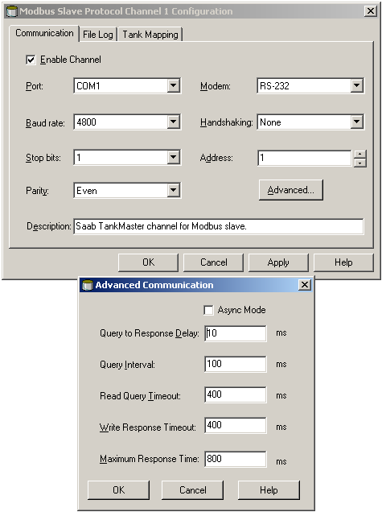
Communication TankMaster- HOST
Set Communication Parameters to match the Host
Address:
The TankMaster Slave address
Query to Response Delay:
Delay before send answer to Host
Query Interval:
Set the same as the HOST polling rate
Read Query Timeout:
Defines when indicating Timeout (no query from Host)

Slide 40
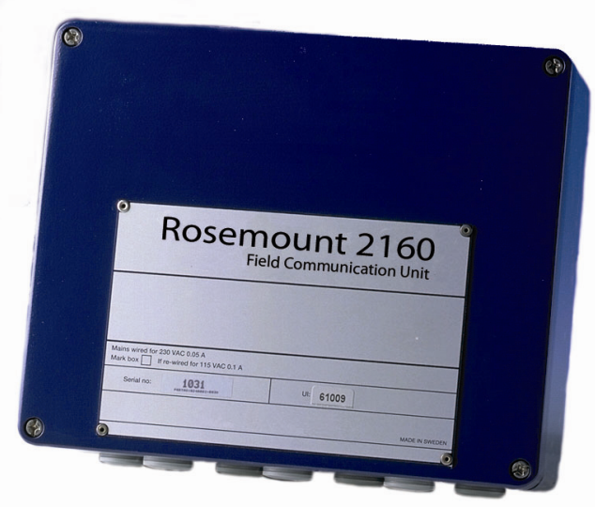
FCU Communication
Field Bus
C-fail to RTG
RTG address in FCU Slave database
Power to gauge
Communication wires
One gauge or complete FB?
Group Bus
TankMaster C-fail
Power to FBM
Protocol enabled and with correct parameters.
Communication log in Win Setup
HOST - No answer from FCU
Asking for correct Modbus address
Using the correct Function Code
Correct Hand shaking
Cables/connections

Slide 41
FCU Communication
Green diodes: serial data received
Yellow diodes: serial data transmitted
Red diode: watch dog
Green LED: power on
Good first step of trouble shooting!
Communication between FCU and field
Check field bus diodes
Is any data sent from FCU (Yellow blink)
Is any data recieved from field (Green blink)
Communication between Host and FCU
Check group bus diodes
Is any data coming from HOST (Green blink)
Is any data sent back from FCU? (Yellow blink)
FCU led indications:
Group Bus (slave):
Field Bus (master):
Green (Question)
Yellow (Answer)
Yellow (Question)
Green (Answer)

Slide 42
FCU 2160 Communication
Normal field bus processing
All FB’s querying at same time
High update rate from field equipment
Single field bus processing
Multiplexing the FB’s
Set in HR 710 = 1
A restart of the FCU is required
Will slow down update rate of all field buses
Use if cross talking between field buses
Number of retries
Set in HR 47
Default = 4
Could slow down update rate of the field bus
FB1
FB2
FB3
FB4

Slide 43
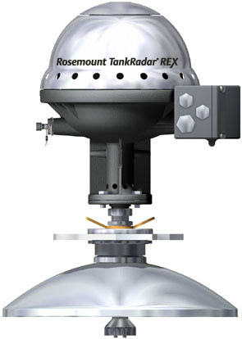
FCU Communication
Cross talking
Can appear if shielding is bad and/or the cables run parallel for a long distance
Other systems with cables close to ours can also disturb the TRL2 bus
Check Green LEDs (answer from RTG) on Fieldbus: one query=one reply!
Solutions
Separate cables / better shielding
Single Field Bus operation in the FCU activated
Holding register #710 set to 1
FB 1
FB 2

Slide 44
Trl2 bus Communication
Check cables!
Good condition of cable
Good connection in junction box
Check that cable is shielded and only connected in FCU.
Install a resistor in parallel with the field bus. (15-100 Ω)
Changes the impedance of the field bus
Impedance affects the frequency of the Tlr2 bus
100 Ω is normally ok Connect at FBM side or FCU side
Sometimes at gauge JBi helps
Loop resistance should not be more than 200 Ω.
In FBM2180 a 100 Ω is built in for easy termination

Slide 45

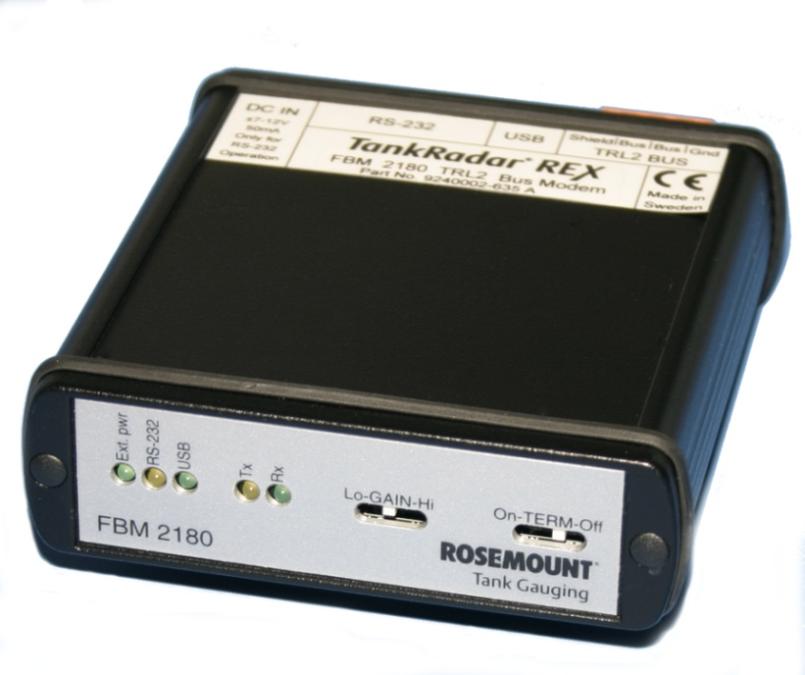
Trl2 bus Communication
Supervising Field bus communication, or HOST communication
This has to be done with external Modbus listener and connected via FBM
E.g. Modbus Scanner, Bus Monitor or ModScan32

Slide 46
Field Devices: Finding error codes, default loading & upgrade firmware

Slide 47
Registers…
The gauge database consists of two types of registers:
Holding registers (read&write)
Input registers (read only)
Holding registers - all fixed parameters
Tank distances
Antenna type
Input registers - all measured data
Level
Temperature
Status

Slide 48
Useful registers
REX 3900 + PRO
Input registers
# 1000 Device Status
# 1002 Device Error
# 1004 Device Warning
# 1102 Device HW Config
# 4002 Measurement status
# 4006 Level
# 4008 Ullage
# 4012 Signal strength
# 4108 Internal temp
# 4202 Number of Echoes found
Holding registers
# 2 RTG Modbus address
# 3 DAU address
#5 System control (DAU)
# 69 Display control
# 1020 Tank Environment
# 1024 Tank Presentation

Slide 49
Useful registers
DAU
Input registers
# 11 to 24 Spot temp
# 25 Temp in liquid
# 26 Blocked sensors
# 27 Temp errors
# 28 Avg temp.
Holding registers
# 193 DAU Modbus address
# 194 Associated RTG address
RTG 2900
Input registers
# 2 RTG status
# 4 Level
# 5 Ullage
# 116 Signal gain
# 117 Amplitude before filter
# 118 Amplitude after filter
Holding registers
# 2 RTG Modbus address
# 3 DAU address
# 41 General threshold

Slide 50
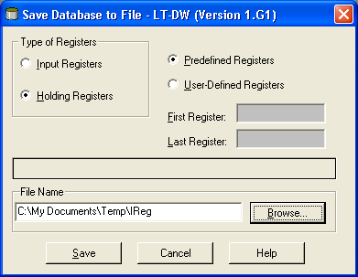
Gauge database
Database backup
Can easily be saved from TankMaster or Radar Master
Uploading to new THE possible
“Backup” good to have if a gauge goes down and needs to be replaced.
All setting been transferred with just some “clicks”
A back up is recommended to take directly after commissioning to secure a “fresh” copy.

Slide 51
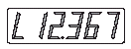
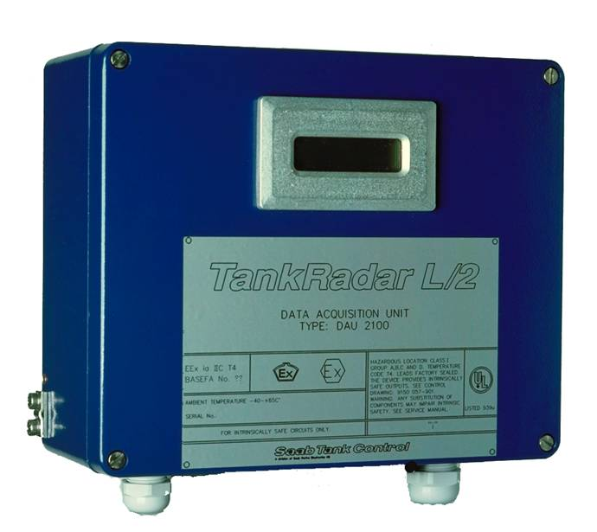


DAU Display
Level value
Temperature value
C = Celsius
F = Fahrenheit
Error Codes
E00030 = Average temperature error
E02000 = Communication with REX lost
Additional Error messages can be found in REX Service Manual

Slide 52
Default loading
Why…???
Error in database
Watchdog on in FCU and not cleared after restart.
IReg in RTG indicating Hreg error.
Error code given in DAU display even after restart.
EX0X00 (first or third digit)
Wrong or unknown configuration
Erasing all user made setting,
get a fresh start over…
If problems with the database has been discovered do not use a back up file to restore the setting.
You might copy in the error again…

Slide 53
Default loading
How…???
REX 3900 and PRO
Holding register #65510
Set value to 65510 and store to gauge
Modbus address and gauge factory calibration will remain
RTG 2900
Holding register #65510
Set value to 65510 and store to gauge
Gauge factory calibration will be lost and the values has to be noted down before action is taken.
HReg 10, 11, 32, 36 and 39
Modbus address will remain

Slide 54
Default loading
How…???
FCU
Jumper X14 and X15
Alternate jumpers and power in a sequence.
Modbus address and slave database will be erased
DAU
Program EPROM exchange
Remove program EPROM
Insert DB-loader prom
Remove DB-loaded and replace Program EPROM.
Modbus address and all settings will be erased

Slide 55
Upgrading the REX firmware
Why?
If new functions are available or some function has been improved
Latest SW available on RepWeb
What is the difference between different SW versions?
Revision history
How long time does it take to upgrade?
EEPROM very fast
Direct communication (20-30 minutes)
Via FCU (20 – XX minutes, Not recommended)

Slide 56
Upgrading the REX firmware
Reprogramming with MODBUS protocol (Win Setup)
Procedure
Upload
Restart
Default load
Programming
First file: Boot SW, REXxxxB.CRY file
Second file: Application SW, REXxxxA.CRY file
xxx = actual version of REX SW
Always start with the Boot SW!
Exchanging EEPROM
Program stored in EEPROM on the SPC board
Simply exchange EEPROM
Beware of ESD shocks!

Slide 57
Upgrading the PRO firmware
Reprogramming with MODBUS protocol (Win Setup)
This procedure is applicable for both Pro TH 40 and TH 43
Programming
First file: Boot SW, ProxxxB.CRY file
Second file: Application SW, ProxxxA.CRY file
xxx = actual version of PRO SW
Exchanging EEPROM (ONLY old PRO TH40)
Program stored in EEPROM on the MB40 board
Simply exchange EEPROM
Special tool to remove EEPROM is needed
Beware of ESD shocks!

Slide 58
Upgrading FCU & DAU firmware
FCU
Exchange EEPROM
Simply change the EEPROM
Database is kept even if EEPROM is exchanged
Special tool to remove EEPROM is needed
DAU
Exchange EEPROM
Change EEPROM
Must run DB Loader of same version before inserting new EEPROM
Special tool to remove EEPROM is needed

Slide 59
FCU 2160 Upgrade Of Software
Software upgrade is done by changing EPROM
A label on the EPROM says which software version it contains
Revision history gives information about software versions
Latest software is 3.D1
Rex is supported from 3.C0
Pro is supported from 3.D0
3.A0 and later requires a FCP board with part number -572 or higher
Part number

Slide 60
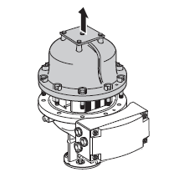
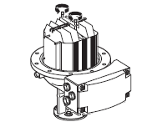
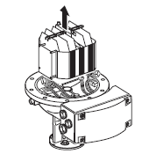
Exchanging REX THE
Remove the cover
If screws are sealed, make sure there is no warranty left before breaking it.
If there is still warranty – contact Rosemount before breaking the seal
Completely remove the seal so that it does not damage the threads. Loosen the screws and remove the cover
Loosen the two screws which hold the electronic unit and carefully lift it up.
Handle the Electronic Unit carefully. Be especially careful with the PTFE plug at the center of the bottom of the Electronic Unit

Slide 61
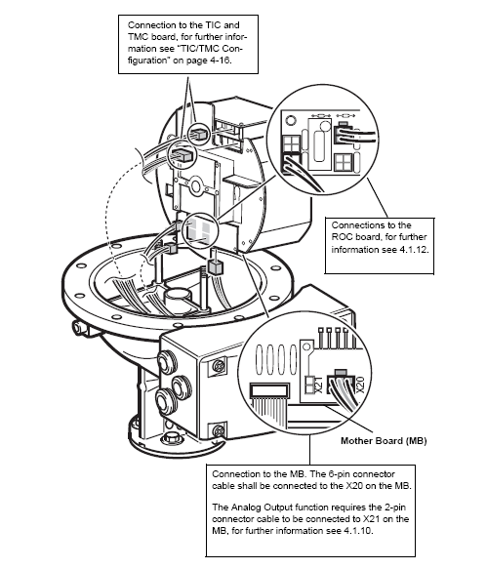
Replacing the REX THE
Connect the cables to the THE. Press firmly so that the connectors lock into place.
Cables to be connected are:
TIC/TCM card – X2 or X3 connector depending on how many temp spots the gauge is configured for
ROC board / Motherboard depending on Analog Output enabled or disabled
Motherboard X20 (and X21 if Analog Output is enabled)

Slide 62
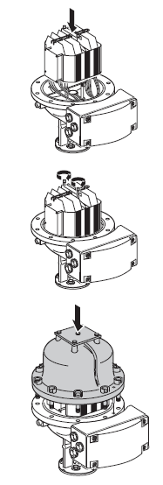
Replacing the REX THE
Make sure the PTFE plugs are clean.
Lower the THE.
Make sure the cables are not stuck between the THE and the base of the enclosure. The THE must rest firmly on the base so that there is no gap for the microwaves to bridge.
Tighten screws on the bar to secure the THE
Replace the cover. Check that contact surfaces on the transmitter housing and cover are clean. Tighten screws.

Slide 63
Temperature reading
Configuration problems
Sensor Type (spot, avg)
Temperature Range
Distances
Number of Elements must match Configuration
Electrical problems
Connection
Reference Resistor (SDAU)

Slide 64
Temperature reading
Typical problems
Avg. temp error when tank is empty
No sensor in product (Normal error)
Wrong Avg. temp but spots are ok
Check sensor positions
Wrong Avg. temp error, one temp is showing error
Check connection
Measure resistance given from the spot sensor.
Low resistance -> Short cut in cable
High resistance -> Break in cable
If broken exclude the spot from Avg. calculation.
Irratic jumping of temperature spots
Check electrical connections, corrosion?
Check shielding of cables
External disturbances??

Slide 65
TankMaster: Missing values, missing volume calculations, values status and upgrading TankMaster

Slide 66
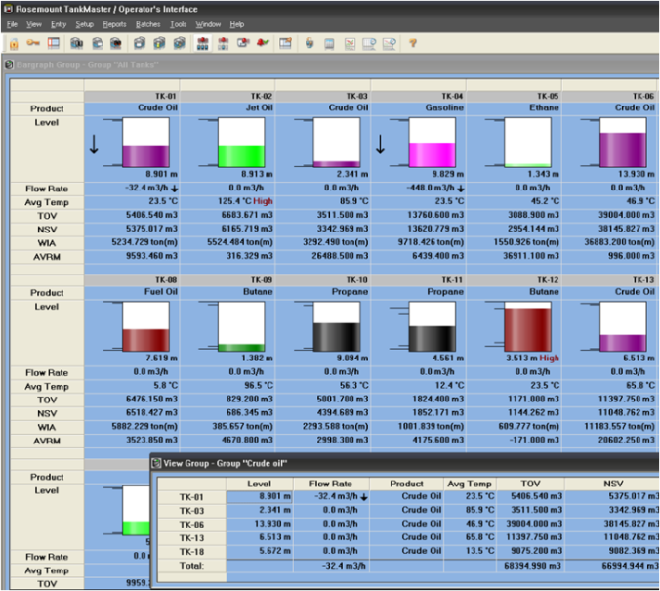
TankMaster
Most common questions
Missing or wrong field values
Missing volume calculations
Meaning of value status
Upgrading TankMaster

Slide 67
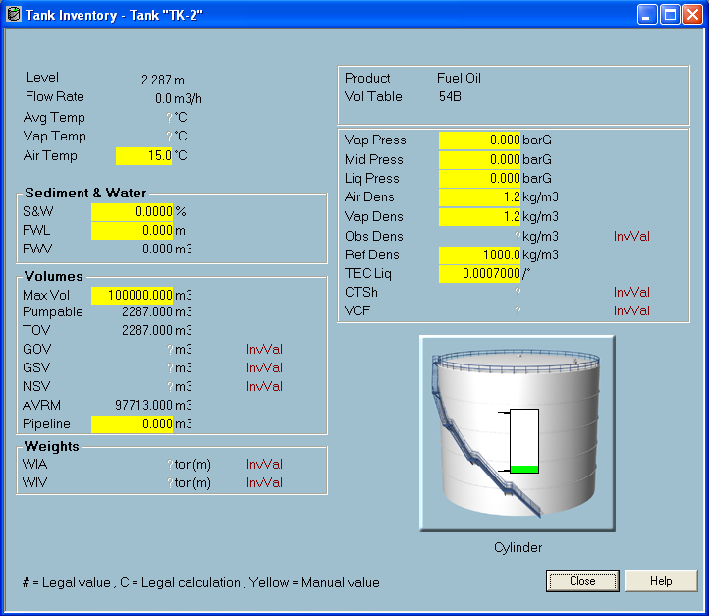
Missing or wrong field values
Missing Avg. Temp
Missing Vap. Temp.
Question mark indicates that no field value is connected

Slide 68
Missing or wrong field values
Check Avg. temp value connection in Winsetup
Go to Tank Entry in ’properties’ of the tank
It shows ’None’ which means no field gauge is connected to this input value

Slide 69
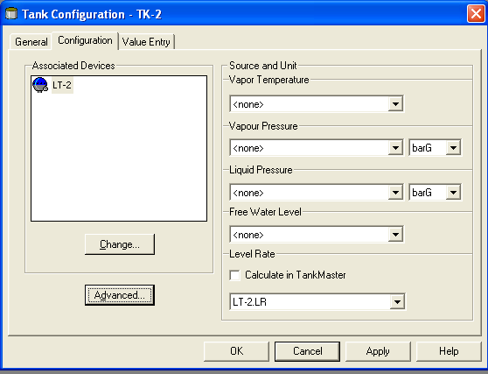
Missing or wrong field values
Go to configuration tab
Click ’Advanced..’

Slide 70
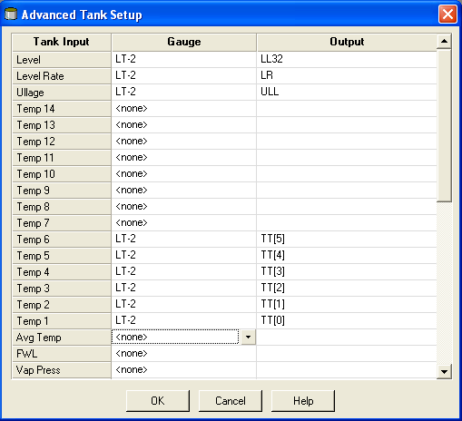
Missing or wrong field values
In Avg temp. item is says ’None’
No input selected

Slide 71
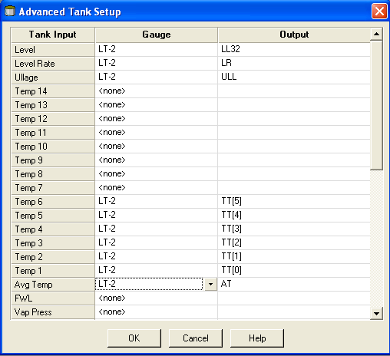
Missing or wrong field values
Select correct gauge and the OPC item AT
’AT’ =Average temprature.

Slide 72
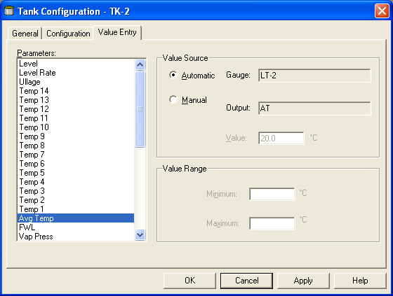
Missing or wrong field values
Check ’Value Entry’
Automatic shows
Gauge LT-2
Output ’AT’

Slide 73
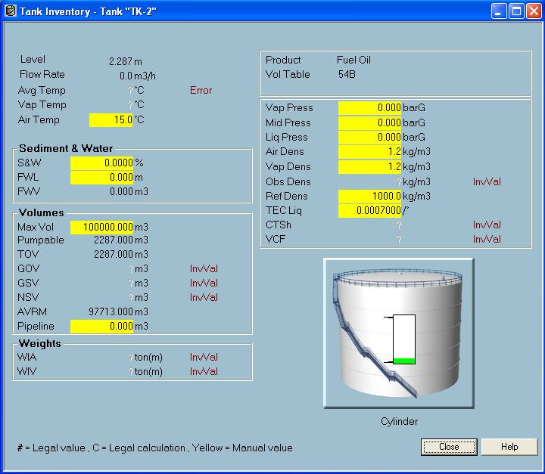
Missing or wrong field values
Avg. Temp is still showing?
Status shows ’Error’
If status is shown a field value is connected.
Temp sensor is now connected but is in error mode

Slide 74
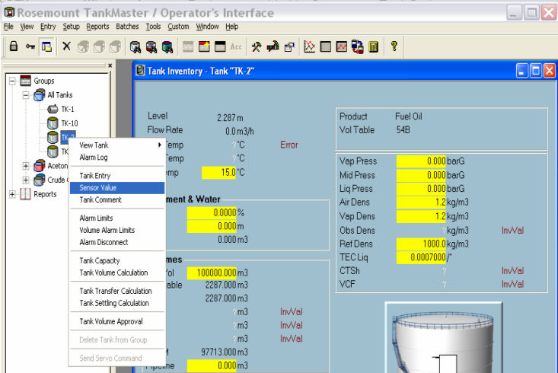
Missing or wrong field values
It is possible to set all input values in WinOpi to manual values from ’Sensor Value’ menu.

Slide 75
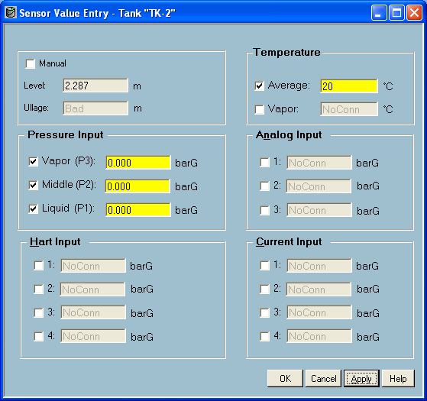
Missing or wrong field values
Set Avg. Temp to manual value 20°C
Manual values are marked with yellow background in WinOpi

Slide 76
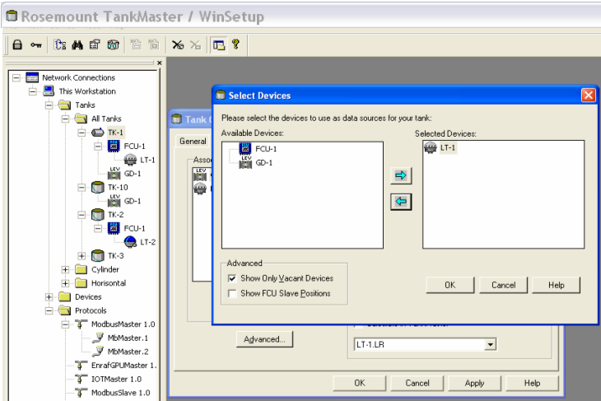
Missing or wrong field values
If a tank is showing values but not correct ones.
Check in WinSetup so correct gauge is connected to the tank

Slide 77
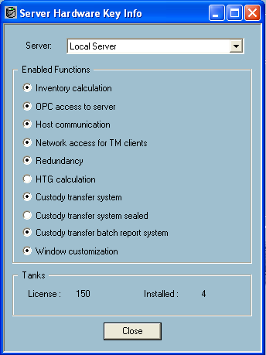
Missing volumes
If no volumes are calculated for any tank
Check WinOpi dongle
Inventory calculation has to be enabled
If more tanks than license allow is installed all inventory calculations stops!

Slide 78
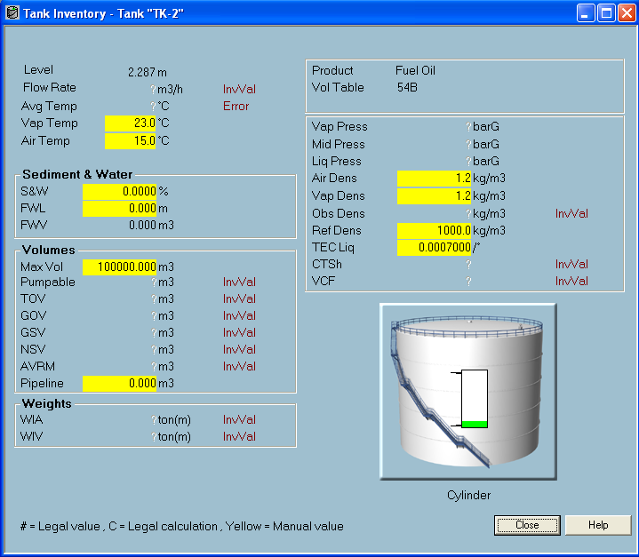
Missing volumes
No volumes are calculated even if we have level, what could be wrong?
Strapping table is probably missing

Slide 79
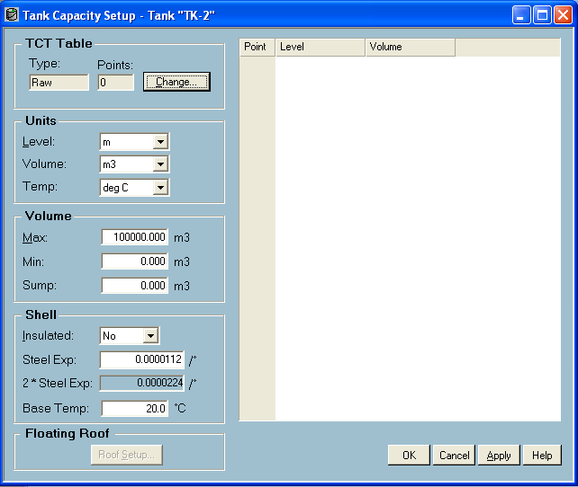
Missing volumes
Checking strapping table.......its empty!!
Insert strapping table

Slide 80
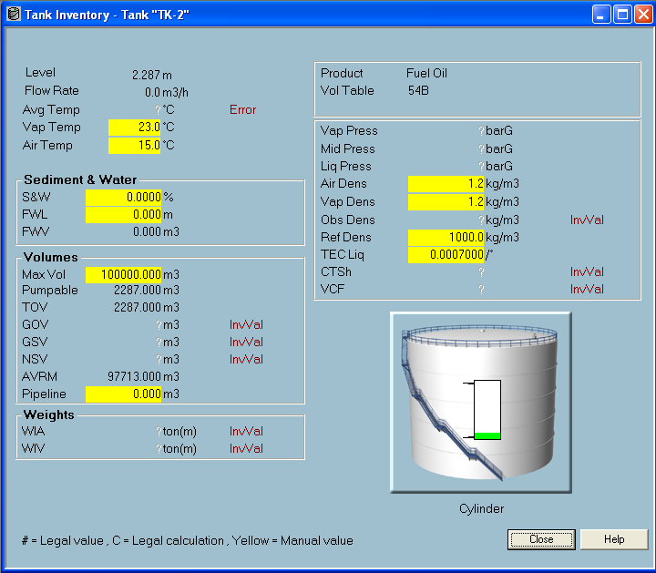
Missing volumes
Now TOV is showing
But why no more volumes??
AHA.............Avg. Temp is missing

Slide 81
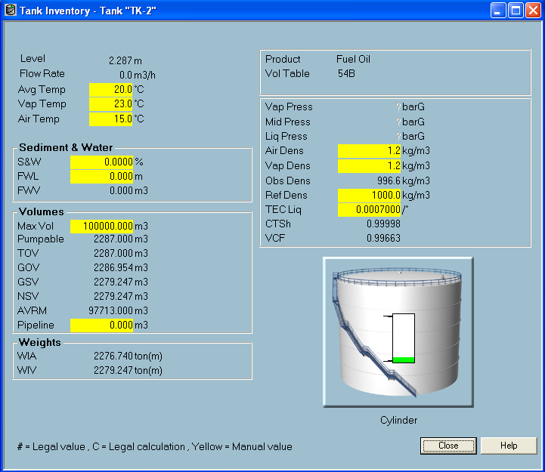
Missing volumes
Set manual Avg. temp to 20°C..
Now all volumes are calculated☺

Slide 82
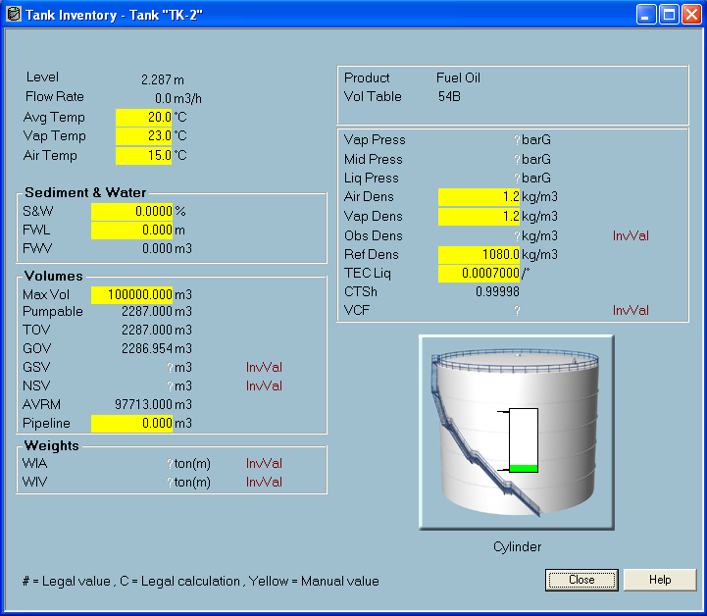
Missing volumes
GSV and NSV is missing!?
Reference density is set outside API table
See TankMaster inventory document page 38

Slide 83
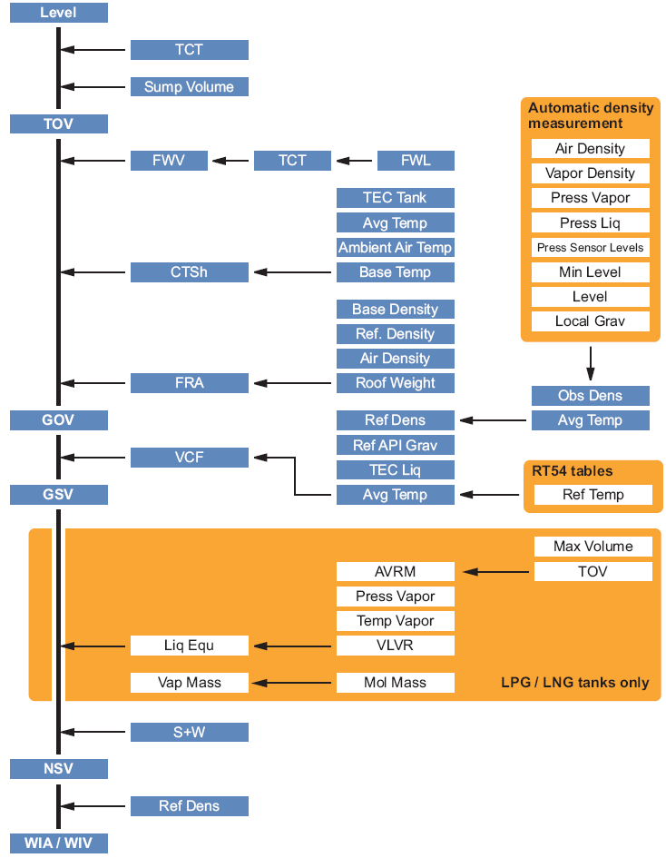
Missing volumes
If volumes are missing check Inventory Setup Checklist in WinOpi p. 4-15

Slide 84
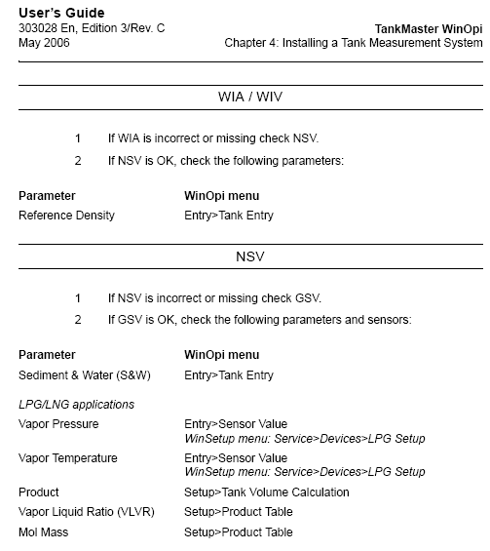
Missing volumes

Slide 85
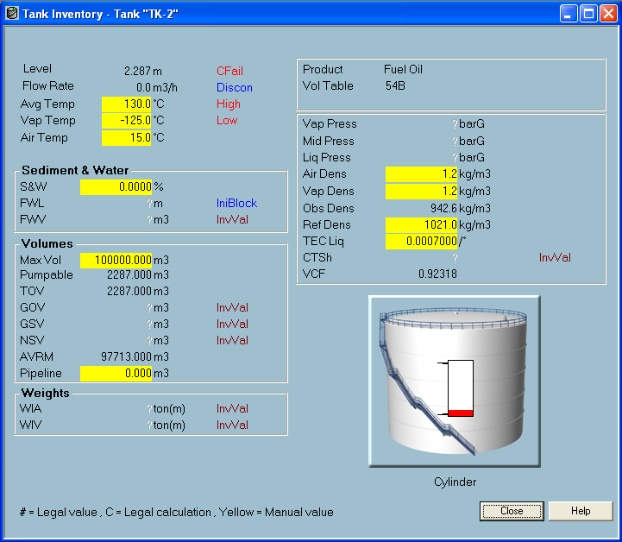
Value status
Each value in TankMaster can have several different status messages

Slide 86
Value status
Alarm messages
Low Value has reached the Low alarm limit
High Value has reached the High alarm limit
LeakLo Value has reached the LeakLo alarm limit
LeakHi Value has reached the LeakHi alarm limit
LoLo Value has reached the LoLo alarm limit
HiHi Value has reached the HiHi alarm limit
Discon Alarm is manually disconnected from the alarm handling
Error messages
IniBlock Tag not initialized, other necessary tags are missing
Blocked Sensor not used, e.g. excluded from avg.. temp. cal.
InvalidValue Other necessary tags are invalid (only calculated tags)
Error Device Sensor Error (only non-calculated tags)
CFail Device Communication Failure
OutOfService Tag is not scanned by Tank Server
NoSource No sensor is connected to tag

Slide 87
Upgrade of TankMaster
Why upgrade?
New functions or bug fixes available
Do not upgrade if not necessary!
Note that minimum requirement of PC is normally increased with newer Tank Master versions
Upgrading
Always make a backup before starting the upgrade procedure (use Administrator window)
Insert CD with new version and run installation wizard
After installation procedure – Reboot PC
Database will remain
Downgrade
Uninstall TankMaster
Delete complete Saab folder
Might not be possible to restore backup if it is taken from a newer TankMaster version

Slide 88
Backup/restore of TankMaster
Automatic Backup
Use StmAdministrator tool
Manual backup
Copy following folders in the Saab directory
OPI / Data Server / Data Setup / Data
With the files in those folders it possible to re-create the system at any time and on any PC
Automatic restore
Use the restore wizard in StmAdministrator
Note! Do not restore windows register if backup is taken from another computer
Manual restore,
Copy following folders in the Saab directory
OPI / Data Server / Data Setup / Data

Slide 89

Backup/restore of TankMaster
Backup of Tank Master is done from administrator progam
Important to do after finished installation of Tank Master
Should be done when changes has been done in the system
Note Configuration in gauges will not be included in backup. This has to be done by saving holding registers to a file WinSetup Manual 15.2

Slide 90
Backup/restore of TankMaster
Tank Server
Installed devices, tanks, strapping tables etc.
Historical data
Sampled data
WinOpi
Custom views
Product table
WinSetup
Protocol and port settings
Register Key for Tank Master
Windows register for TM installtion

Slide 91


Backup/restore of TankMaster
Make sure that Tank Master is running.
Then specify a folder to make the backup in
A popup message will tell you when backup is done
Easy to restore

Slide 92

Backup/Restore of TankMaster

Slide 93


Backup/restore of TankMaster

Slide 94


Backup/restore of TankMaster

Slide 95



Backup/restore of TankMaster

Slide 96
Backup/restore of TankMaster
Folders that need to be copied
..\server\data
..\opi\data
..\setup\data
To restore a backup
Make sure that Tank Master is NOT running
Copy data in backup folder into correct folder in Tank Master installation directory.
..\backup\server\data ..\rosemount\server\data
..\backup\opi\data ..\rosemount\opi\data
..\backup\setup\data ..\rosemount\setup\data
Start Tank Master

Slide 97
Service tools, Hardware, Software & Documentation

Slide 98



Service hardware
Common tools such as screwdrivers, torx & Allen keys, pliers.
Get our ‘Service Toolkit’ and you are safe!
Fieldbus Modem
FBM2180 is recommended
Power supply if using RS-232
USB & Serial cable
Cabling
Twisted pair cable, X meters
For connection between FBM-FCU
Orange connectors
Resistors (appr. values , ½ W)
10, 33, 47, 75, 100, 150 ohm

Slide 99

Service hardware
Multimeter, measuring:
Voltage
Resistance
Current
If you have to troubleshoot communication of any kind
RS-232, ‘null-modem’ cable
RS-232, ‘straight’ (FBM) cable
Gender changers
RS232/485 converter (i.e. K2-ADE)
((….worst case, breakout box))
(Emulation)
Enraf: EBM
(Oscilloscope)
For advanced users
Check Fieldbus disturbances

Slide 100
Service hardware
Personal Computer
Within TankMaster minimum requirements
Win XP installed SP2
TankMaster/Radar Master installed and tested with FBM before leaving office!
Any additional software you might need, tested when having TM/RRM installed.

Slide 101
Service software
TankMaster
Installation CD
Radar Master
Installation CD
Miscellaneous software for troubleshooting (should also been installed/tested before use)
Bus Monitor
(listen to communication on TRL/2 bus)
A Modbus ‘scan’ software, i.e. Modscan
Acting as a Host, asking for Modbus data from slave
OPC browser, i.e. Matrikon
Browse, read, write opc data from/to TankMaster OPC Server

Slide 102
Service software
Firmware
Always check Revision History before upgrading
Only upgrade if really necessary
REX, PRO, TRL/2 can be upgraded using Computer
Bring firmware in PC
FCU, DAU must be upgraded using EPROMs
Bring some EPROMs

Slide 103
Service documentation
Devices (Rex, Pro, DAU, FCU, TRL/2…)
Manuals:
Installation, Commissioning, Service
(Special topics: Emulation, RDU and others)
Revision History
Holding and Input Register description
Avoid getting stuck due to lack of information….!
Notes:
‘För att undvika köra fast pga avsaknad av information, ta med dig:’

Slide 104
Service documentation
Win Setup
Reference Manual
WinOpi
Reference Manual
Inventory Calculations
Revision History for TankMaster
Network
Installation and configuration flow for TankMaster redundancy and network system
Connections, Local and Network (DCOM settings)
Data Item version 2 (lists the OPC tags in TankMaster)
HOST Connecting to TankMaster
Extended Modbus slave Protocol (lists the Modbus registers in TankMaster)
Emulation documents

Slide 105
Facotory Support: how to find information and how to contact us

Slide 106

Tank Gauging web page
http://www.rosemount-tg.com/

Slide 107

Extranet - RepWeb
http://partner.tankradar.com

Slide 108
Company Web vs. RepWeb
Company Web page
open to everyone
Contains manuals, drawings and technical descriptions
RepWeb
open only for representatives and Emerson employees
contains technical documents, marketing and sales material and contact information

Slide 109
Whom to contact if...
...you want to get a quotation for a new gauge: sales
...you want technical advice regarding applications: sales
...you want us to do a site survey: project
...you want to receive advice regarding commissioning: project
...you want to get help with troubleshooting: service
...you want a service engineer to visit you: service
...your installed system is not working correctly: service
...you know that a device is broken: parts

Slide 110
E-mail addresses
Service: service.rtg@emerson.com
Sales: sales.rtg@emerson.com
Project: project.rtg@emerson.com
Parts: parts.rtg@emerson.com

Slide 111
Required information
System number
Site and country
Whether you have discussed this problem with anyone else at Rosemount before (enclose previous emails if possible)
Gauge type and firmware version / Software version if it is a software problem
Antenna type
Application
Problem description (communication problems, software problems, accuracy problems, measurement problems etc.) and which actions that have already been tried
Screen dumps of software problems
Holding and input registers from gauges
Spectra pictures

Slide 112

Subject line
Example of good subject line:

Slide 113

Subject line
Example of bad subject line and too little information:

Slide 114
We need your help…
Do not send separate e-mails to several persons – nobody will ignore your mail. It will just create extra work for us if several persons will independently answer your questions.
If you want to inform the project engineer or area sales manager also, please use CC.
If you get an out-of-office reply with a request to send your e-mail to the service box, please CC the out-of-office person. Otherwise it is hard for us to know if you have already received help from somebody else when we get back.
Please send all new problems to the service box!

Slide 115

Support flowchart
Problem!
E-mail sent to service box
All service engineers read it
One service engineer replies
Rep/customer communicates
directly with service engineer
You will get the fastest response when you send your e-mail to the service box!

